Slide 1
Biodata Update

Slide 2
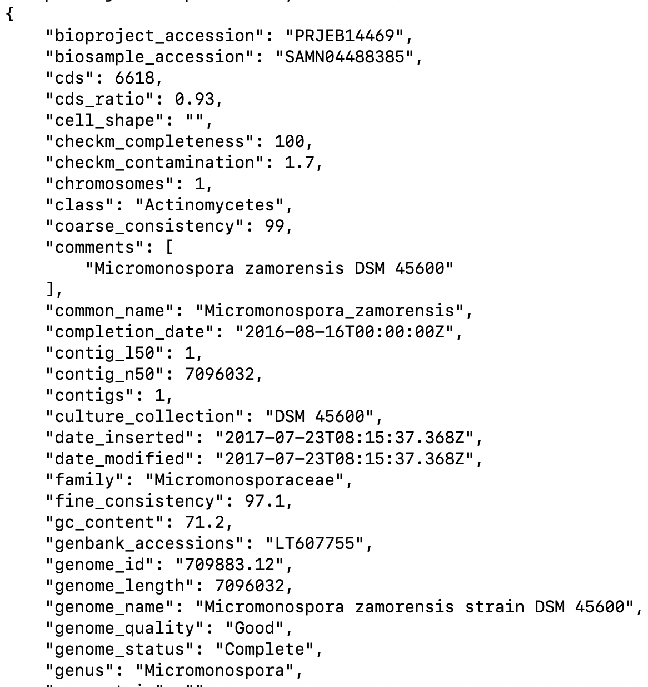
Datasets
BV-BRC: 2100 genomic datasets, many more available
Pathway
Subsystem
Protein-Protein Interactions
Etc
Easy to create templates
modelSeed: 9,485 reaction files, many more available
Biochemical reactions
Metabolites
Harder to create templates
Others available

Slide 3
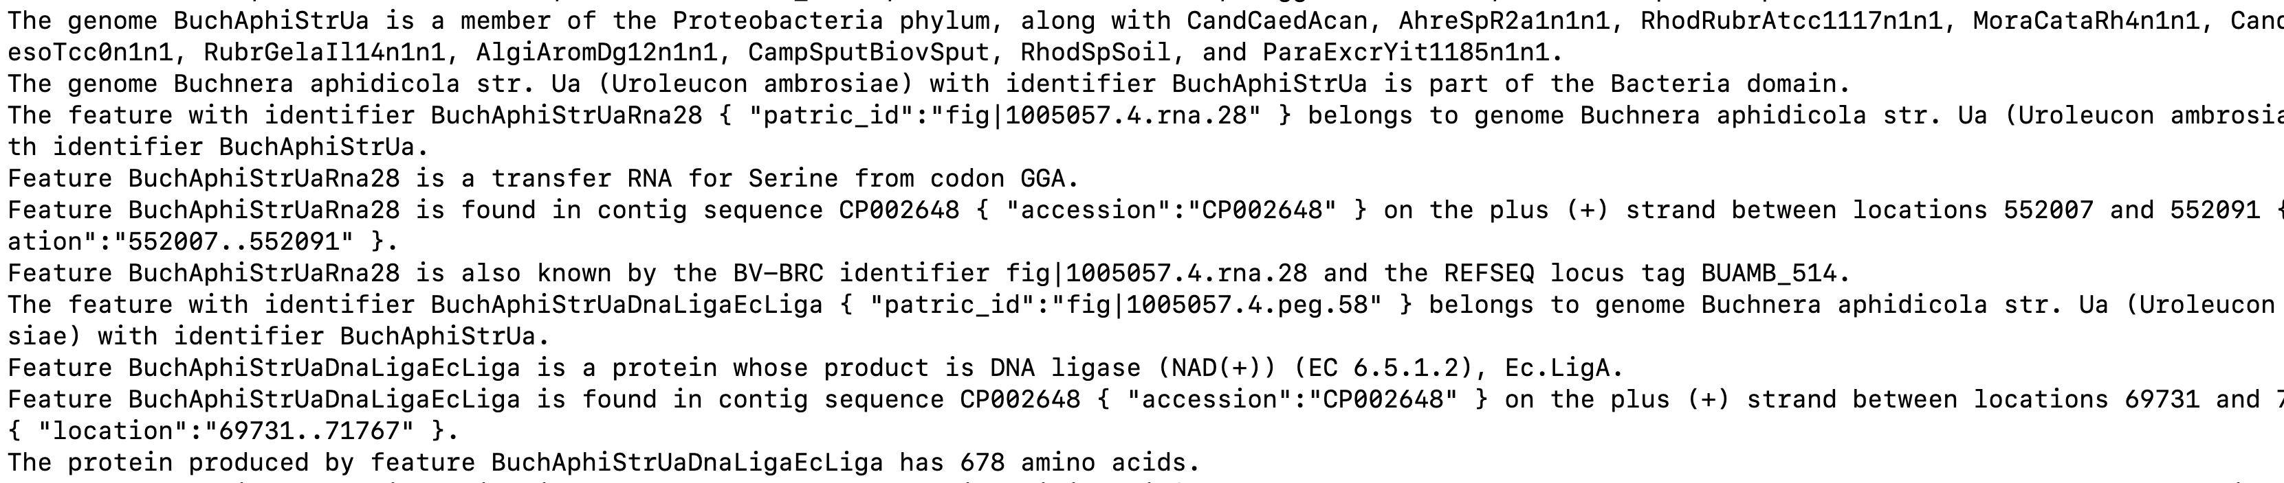
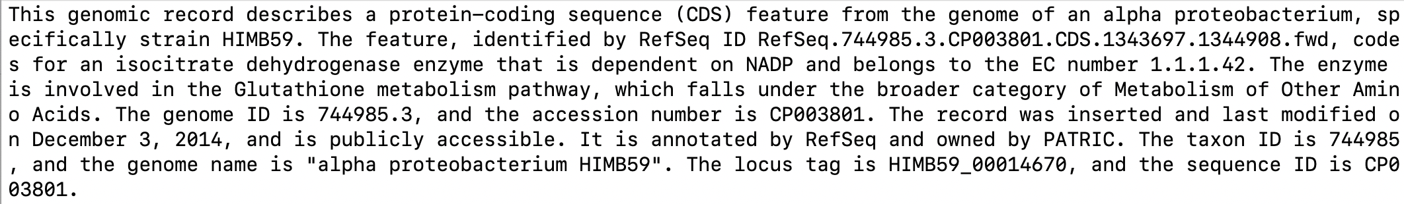
Narratives
Templates:
LLM-Generated:

Slide 4
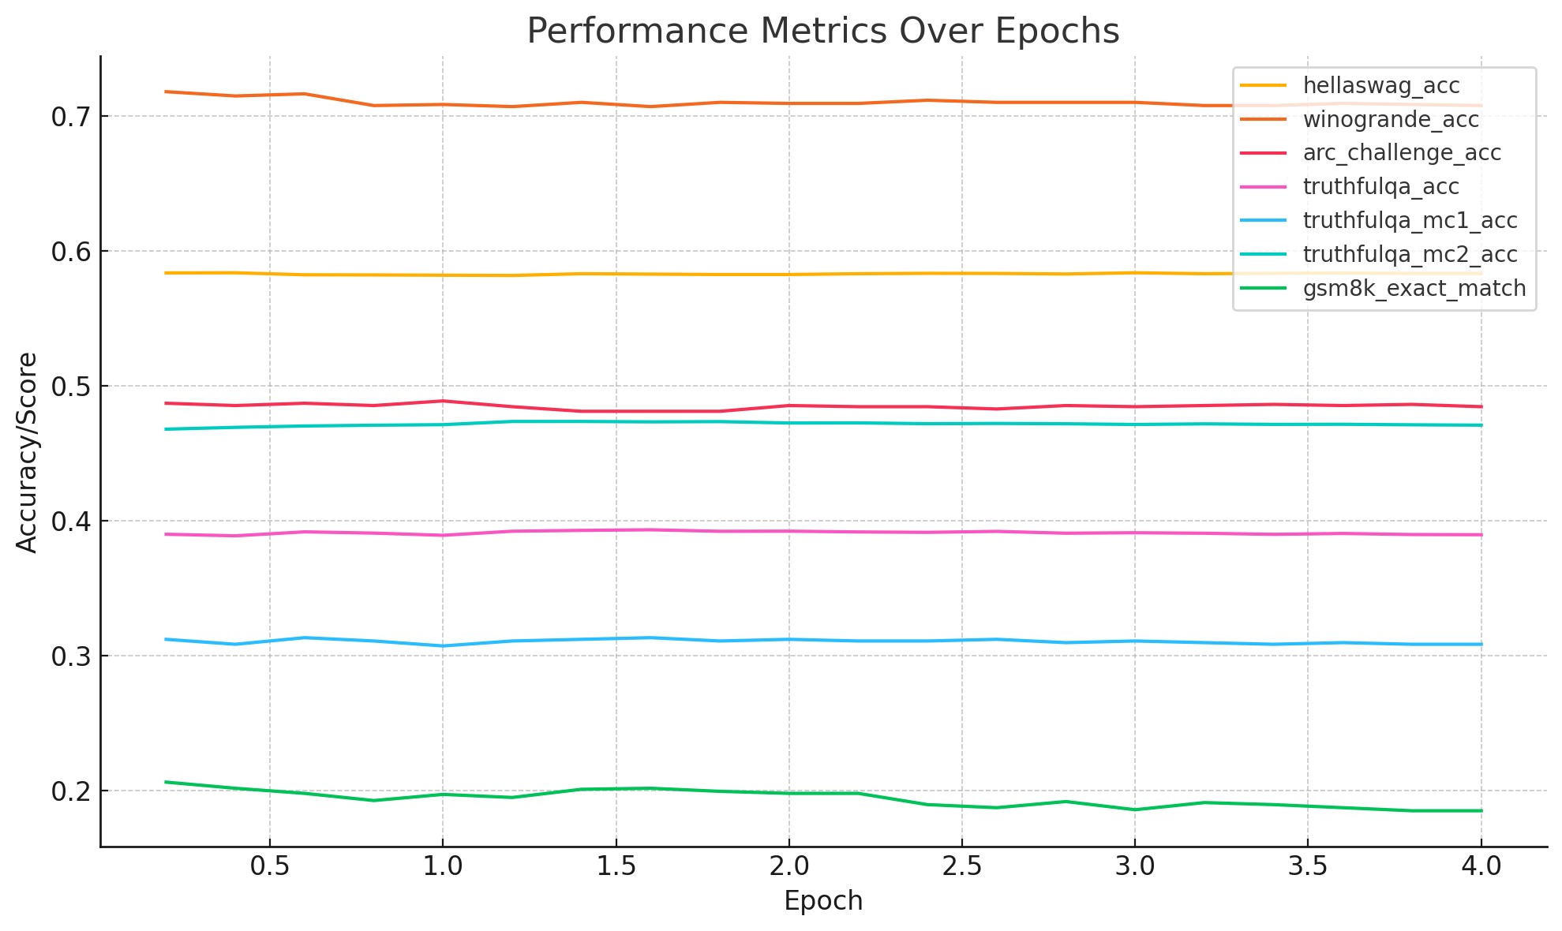
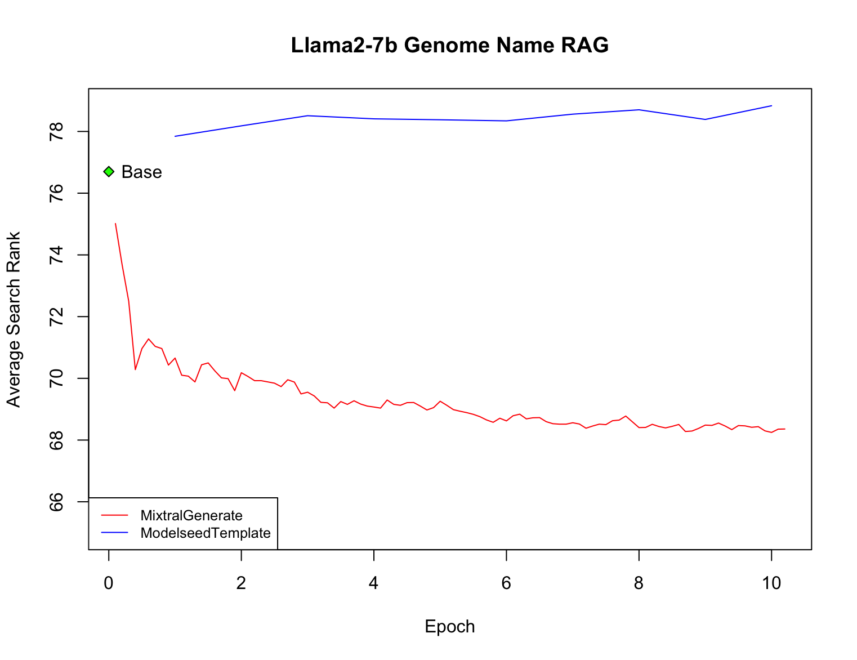
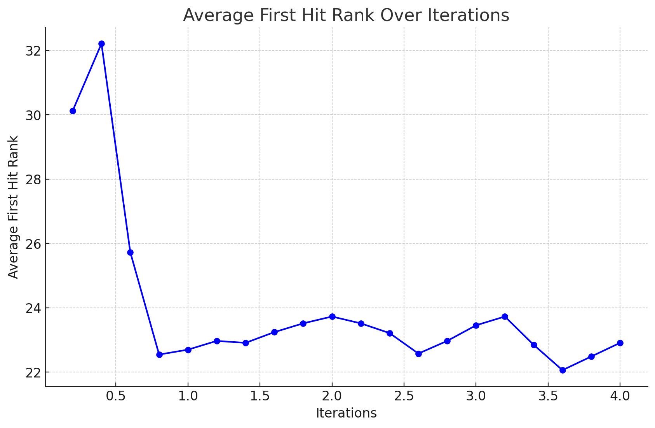
Experiments
Train Parameter Efficient Fine-Tuning (PEFT) models using individual data types or mixtures
Evaluations:
auroraGPT-ANL/lm-evaluation-harness
Custom RAG embedding test

Slide 5
Moving Forward
Generate 1B+ tokens from llm-generated narratives
Progress: 962,164,500 tokens
Inference Endpoints: 669,311,475
Continue to run small scale experiments and establish more
Use results to contribute to Continuous Pretraining Experiments
Develop relevant evaluation datasets
RAG: Enhance the context for the LLM using scientific papers from ASM so that we can provide higher level context on the narratives beyond what is provided from just the template

